Slide 1

Optimization of production portfolios in the upstream oil and gas industry to minimize emissions using Python
Student name: Khoo Wan Ting
Student PI no.: N2081491
Supervisor: Dr. Munish Kumar

Slide 2
Content Page
Project introduction
Business problem and objective
Literature review
Data understanding
Data preparation
Data modelling
Modelling results and evaluation
Limitations and recommendations

Slide 3
Project introduction
Upstream Oil & Gas (O&G) Industry
Optimization
Python - Gurobi
Notes:
1. Finding reservoirs, acquiring land rights, and onshore and offshore drilling of oil and gas wells for production.
2. Finding the optimal mix of assets to achieve the objective
3. High performance – able to find optimal/near-optimal solutions quickly Versatility – supports a wide range of optimization problems (allowing ease in switching modes if necessary)
Gurobi has a Python interface (API) allowing it to be easily integrated with various Python libraries such as the NumPy library used

Slide 4

Business problem and objective
15% of energy-related emissions worldwide
Pressure to reduce emissions
Effects of climate change
Optimize production portfolio
Maximize production while minimizing emissions
Identify assets within existing portfolio to divest
Notes:
O&G operations industry attributable for 15% of energy-related emissions worldwide (5.1bn tons of GHG emissions) Examples of effects of climate change: Frequent changes in rainfall & temperature – negatively impacts agriculture cultivation and water resources, health issues arising from thermal stress and disease burden, and ecological productivity and biodiversity due to sea-level rises leading to extinction of some species.
Research showed that typically, the emissions from gas and onshore fields are less than oil and offshore fields respectively. Therefore, by using intensities stated in the companies’ websites or reports or by estimating their intensities using their respective ratios, the model’s objective is to optimize each company’s production portfolio to maximize production while minimizing emissions by identifying the fields releasing the highest emissions per production unit that should be divested.

Slide 5
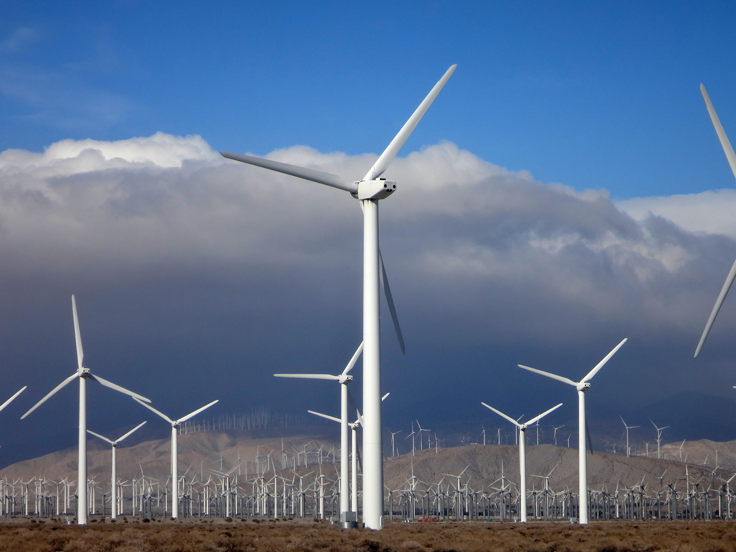
Literature review
Moubarak (2021) Project Portfolio Optimization in a Changing Energy Landscape
16 assets – 10 hydrocarbons, 5 wind farms, 1 Carbon Capture and Storage (CCS)
2 scenarios – 100% investment on CCS/wind farms
Notes:
CCS is a process that captures CO2 steam at its emission sources, then treating and transporting for storage, usually underground thus, reducing the emissions to the environment.
Wind is a renewable energy source thus, releasing less emissions than hydrocarbons (do not contaminate, is inexhaustible, and reduce use of fossil fuels)
Natural gas and crude oil are mixtures of different hydrocarbons.

Slide 6

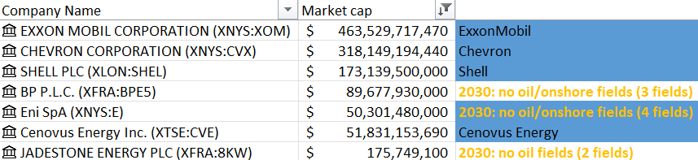
Data understanding
Upstream oil and gas companies in Asia
Company information
Hydrocarbon types
Field characteristics
Focus on 10 companies
5 International Oil Companies (IOC)
5 National Oil Companies (NOC)
ONGC - India
Sinopec - China
PTTEP - Thailand
Petronas - Malaysia
Pertamina - Indonesia
Notes:
Received Microsoft Excel CSV file
Using Excel’s stock function as seen in the image on the right, the companies were sorted by its market capitalization in descending order
& 5 NOC (by selecting 5 countries) while excluding companies where the dataset only has 1 field or are not producing anything in the target year, 2030

Slide 7

Data preparation
Standardised company names & subsidiary names
Filtered data for the focus companies in years 2021 to 2030
Removed unnecessary and irrelevant columns
Multiplied metric values by 1,000 to change the unit of measurement to boe/d
Renamed Condensate and NGL values to Condensate_ngl
Pivoted columns to get Oil, Condensate_ngl, Onshore, and Offshore columns
Duplicated dataset to filter for each company
Replaced empty values in “sector_name”, “sector_country”, and “country_region” with “field_onshore_offshore_break” for Sinopec
Notes:
Examples: Petronas Carigali to Petronas
Shrink dataset size
Data cleaning

Slide 8

Data preparation
Imported each company’s cleaned Excel dataset
Calculate and add intensities and emissions columns to DataFrame
Added a field index column to differentiate the fields
Create 4 new DataFrames for production and emissions of O&G / Offshore & Onshore
Notes:
Emissions/Intensities – either retrieved from company websites/reports or calculated in proportion using the 1:0.73 ratio for O&G and 1:0.33 ratio for Offshore/Onshore
Field index – dataset received do not have field_name nor id_field columns

Slide 9

Data modelling
Decision variables:
Binary
DataFrame index
Objective:
Maximize 2030 production volume
Constraints:
2030’s total emissions to be less than or equal to target
Set decision variables to 0 if there’s no production in 2030
Notes:
Decision variables: set as XX_production.index [all 4 DFs are aligned so, the indices are the same]
Objective
Constraints

Slide 10
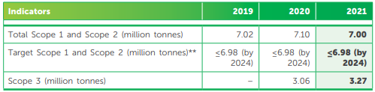
Petronas O&G example
2021 oil production: 210,828.0 boe/d
2021 gas production: 50,289.1 boe/d
2021 total emissions: 7M T CO₂e = 19,178,082.2 kg CO₂e/d
2021 oil emissions: 19,178,082.2 / (210,828*1 + 50,289.1*0.73) * (210,828*1) = 16,333,893.6 kg CO₂e/d
Oil intensity: 16,333,893.6 / 210,828.0 = 77.5 kg CO₂e/boe
Notes:
Oil to gas ratio 1:0.73

Slide 11
Petronas O&G example
2030 target emissions: 6.98M T CO₂e = 19,123,287.7 kg CO₂e/d
2030 total production: 150,767.9 boe/d
2021:2030 production ratio: 261,117.1 / 150,767.9 = 1.7319
2030 proportioned target emissions: 19,178,082.2 / production ratio = 11,041,703.6 kg CO₂e/d = 11.0M kg CO₂e/d
Notes:
Emission constraint set as <= 11.0e6

Slide 12

Data preparation
Optimized production DataFrames exported from Python as CSV files
Combined CSV files for each company by O&G / Offshore & Onshore using Microsoft Excel PowerQuery
Imported into Tableau
Decision variable and Field index columns’ data types were changed to string and dimension
Set hierarchies for Location and Field characteristics

Slide 13
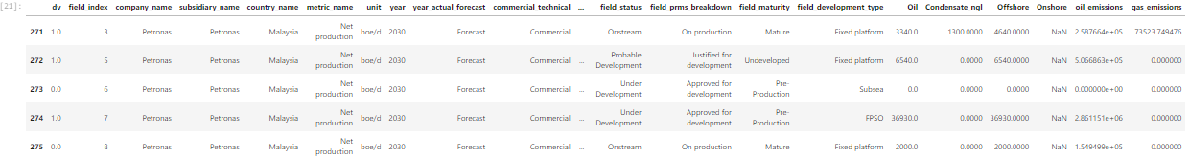
Modelling results and evaluation

Slide 14
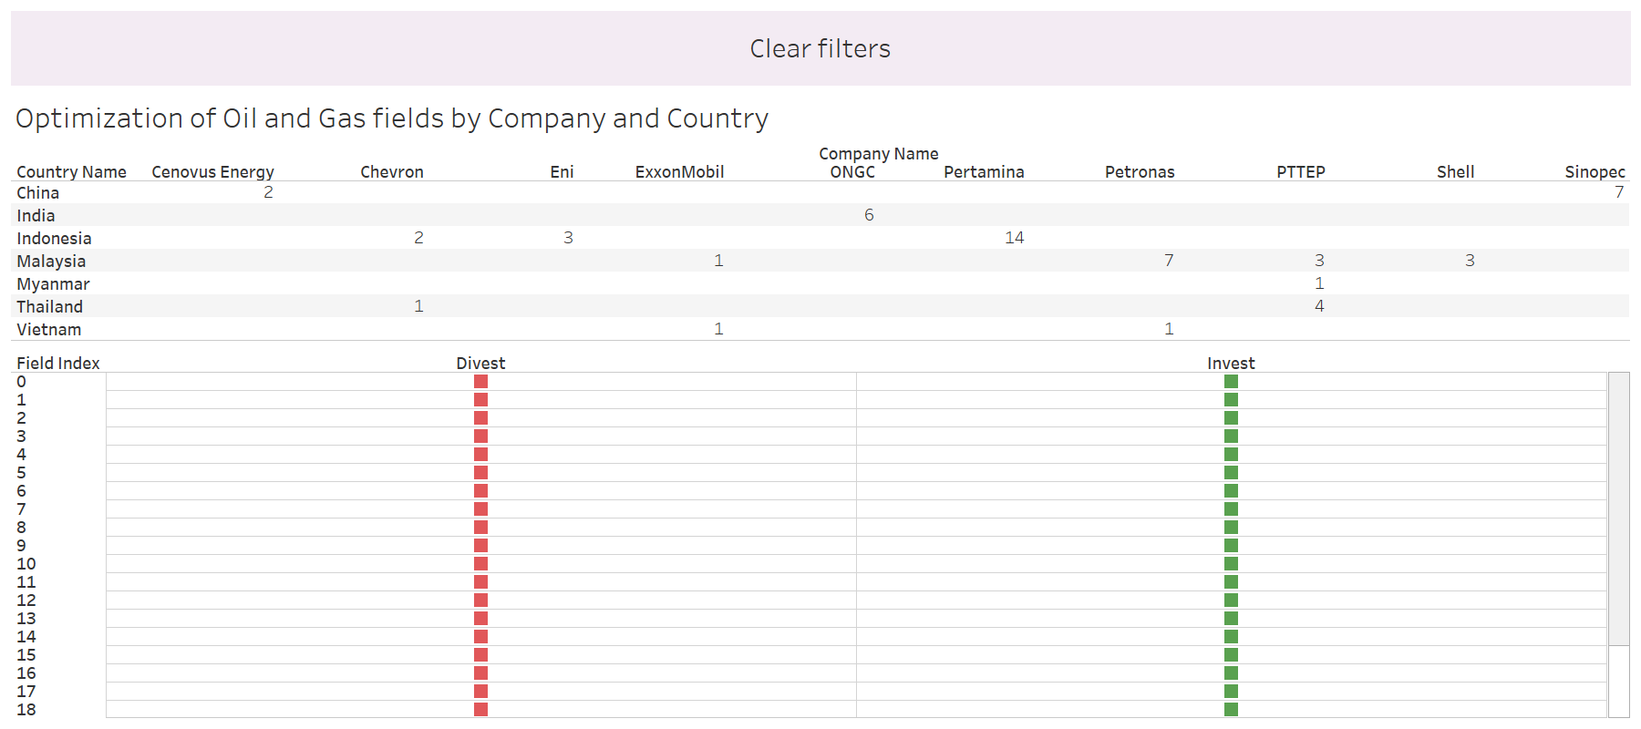
Modelling results and evaluation
Notes:
Petronas O&G example

Slide 15
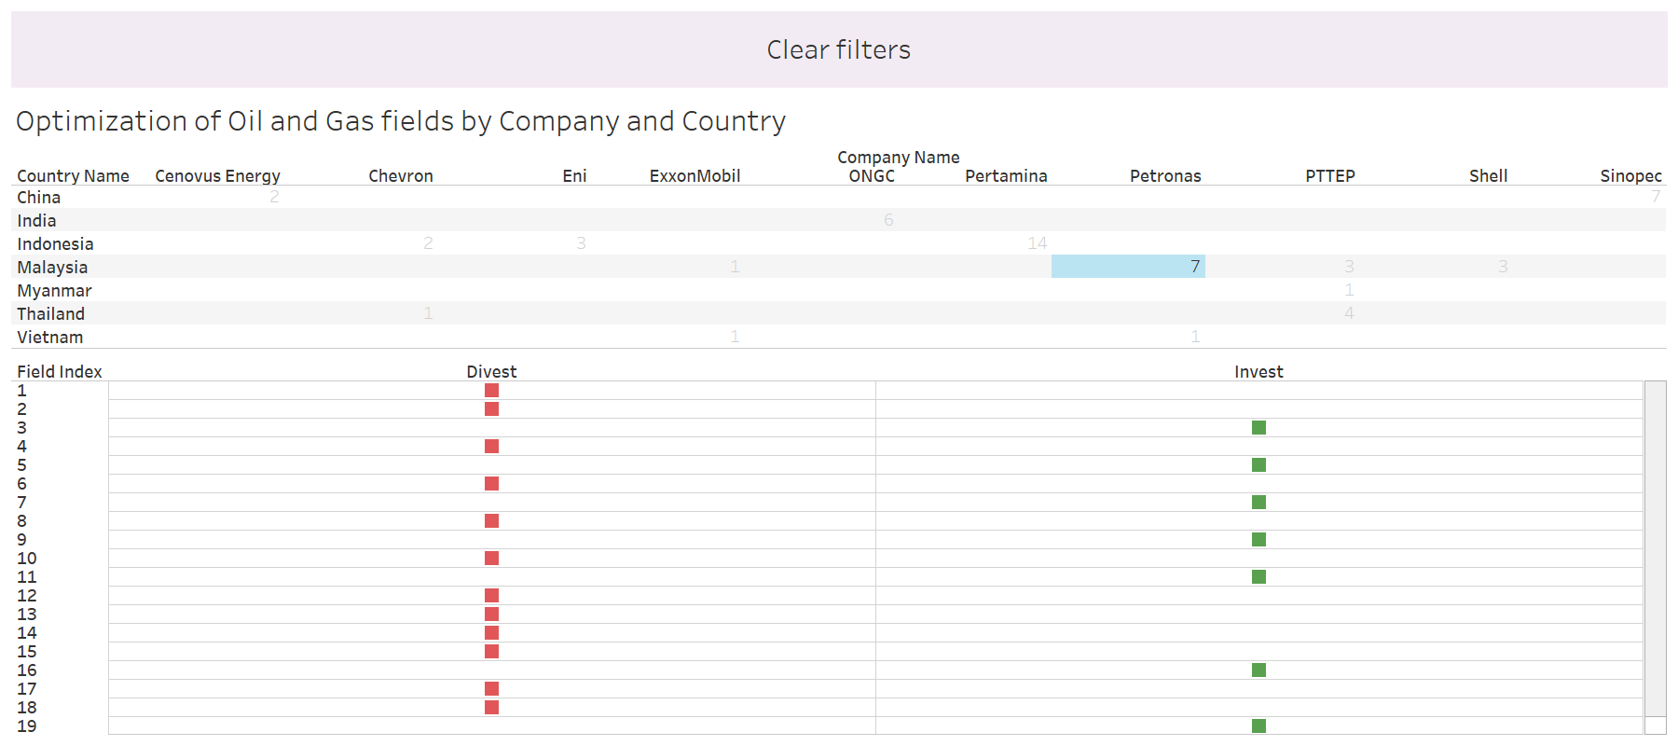
Modelling results and evaluation
Notes:
Petronas O&G example

Slide 16
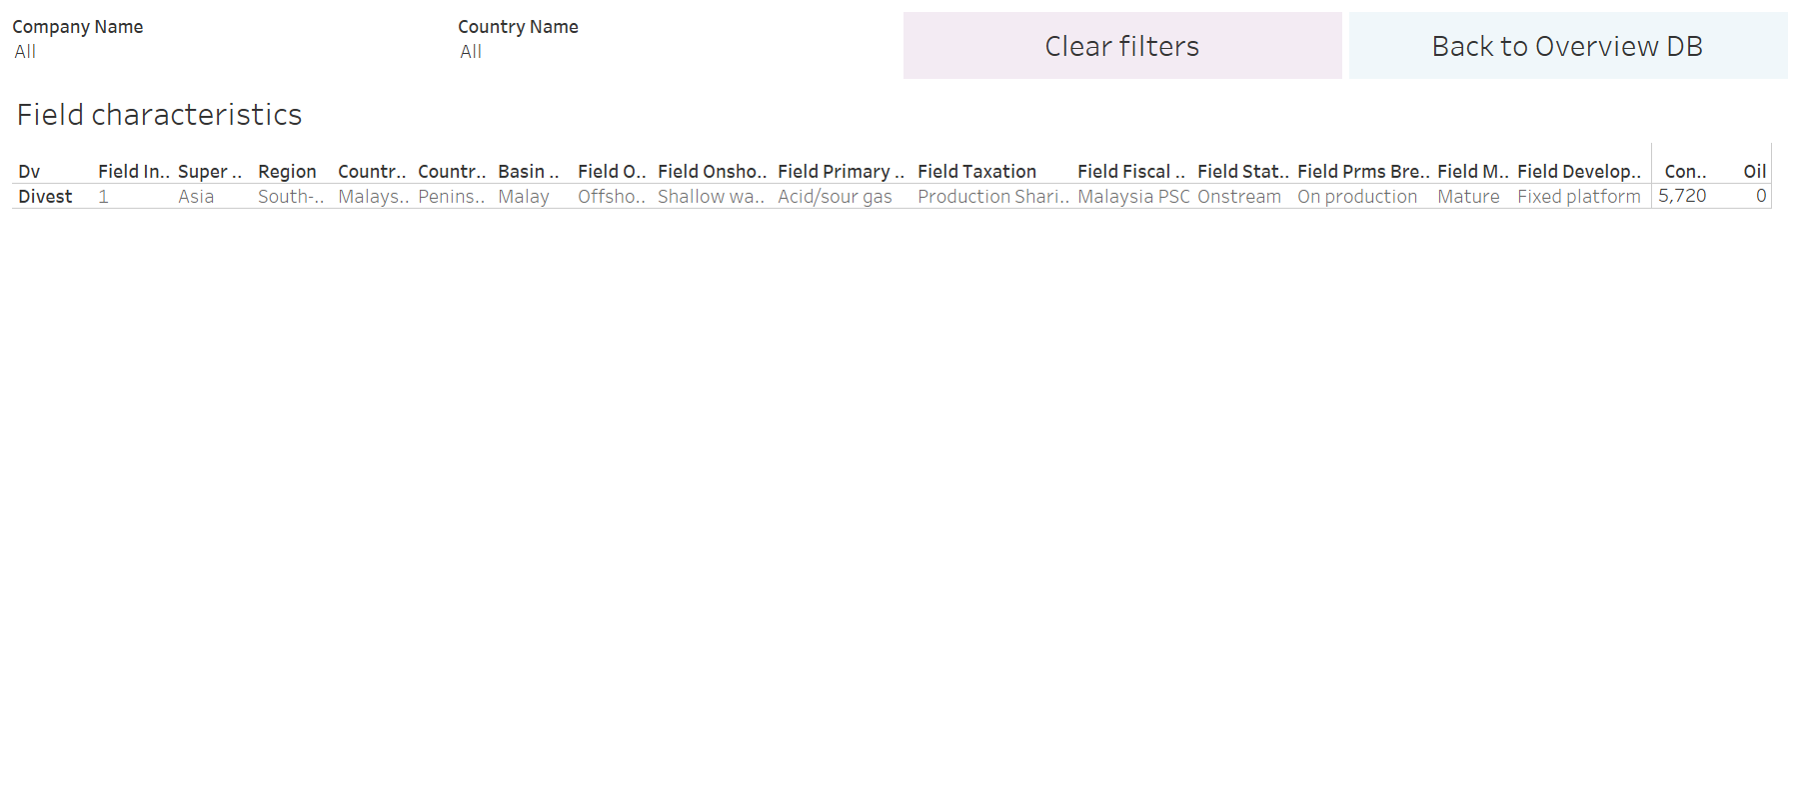
Modelling results and evaluation
Notes:
Petronas O&G example

Slide 17

Limitations and recommendations
Dataset does not take other factors into consideration
Petronas is state-owned by Malaysia, but solution says to divest 13 out of 20 of its Malaysia fields
Might have to add constraints for NOCs to have a 100% investment in their home country’s fields
Restricted free license
Free license for academics, valid for 1 year per registration
Notes:
Other factors such as: geopolitical factors and social factors

Slide 18
THANK YOU!

